Slide 1
Rehabilitation Tax
Credit Workshop
Katie Wilborn, Katherine.Wilborn@ky.gov
Site Development Program Administrator
Preservation Easements & Tax Credits

Slide 2
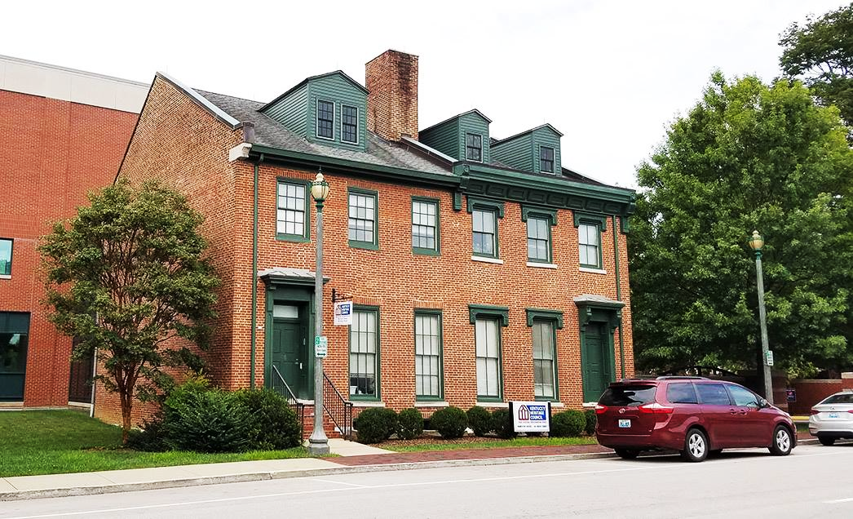
Frankfort, KY
Meet the Tax Credit reviewers!
Katie Wilborn
Patrice Perlman
Gracien Bahizire
Candi Rinehart
Mike Radeke

Slide 3
Program manager: General questions, preliminary reviews, application submissions, & issuing approvals.
Project manager: reviewer & point of contact:
Katie Wilborn
Patrice Perlman
Gracien Bahizire
Candi Rinehart
Mike Radeke

Slide 4
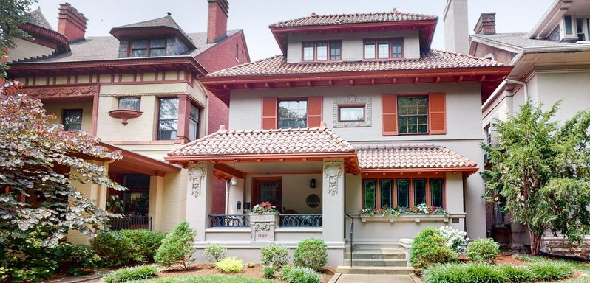
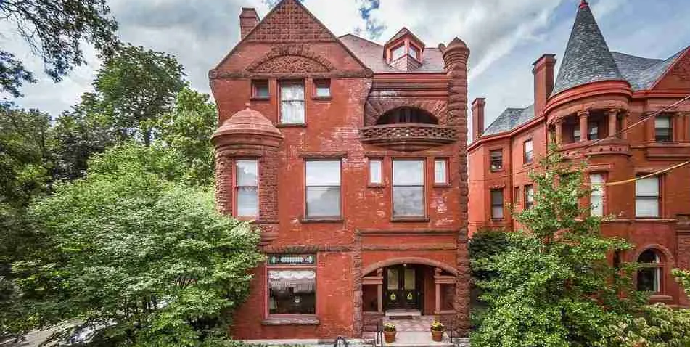
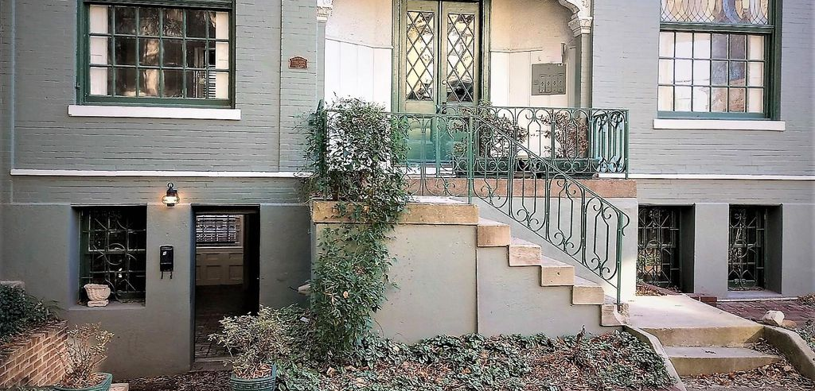
Quick Poll:
Personal Residence?
Income-Producing?
Both: Residence & Income?
Tax-Exempt?

Slide 5
Rehab. Tax Credit Workshop Goals:
Who
What
Why
Where
When
How
is eligible?
are they?
apply?
to get info?
to apply?
to apply
and be successful?
w/ Application Examples
specific to the Old Louisville Residential Historic District
* Property Category | QREs & Credit amount | Contact Information*

Slide 6
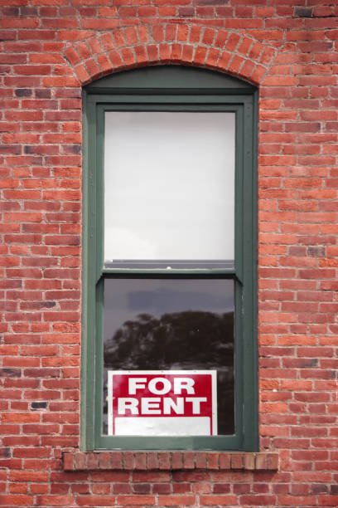
WHO is eligible?
You MUST be the
historic building’s owner,
at the time applying and for a minimum of 3 years after the work is complete, to receive a Rehabilitation Tax Credit.

Slide 7
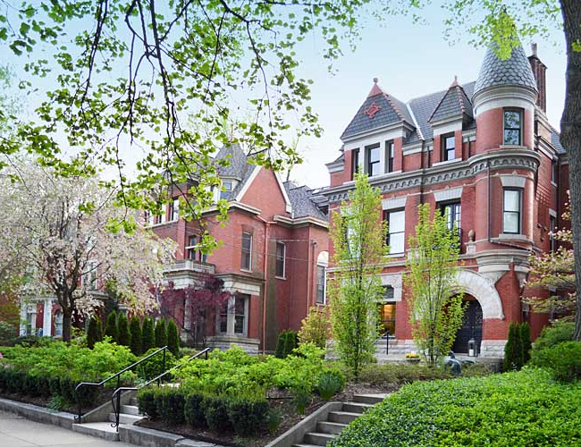
WHAT is a Rehabilitation Tax Credit?
“Rehabilitation”
is federally defined as:
Making a compatible use through repair, alterations, & additions while preserving significant features.
A “tax credit” covers income taxes owed, at a dollar-for-dollar rate.

Slide 8
Income Taxes Paid
WHY Rehabilitation Tax Credits?
These are voluntary incentives to help you maintain your historic
property to the federal Standards of Rehabilitation.

Slide 9
Cost to Rehabilitate .
Rehabilitation Tax Credits
Qualifying Rehabilitation Expenses
“QREs”
20-40%
Reduces taxes paid

Slide 10
Cost to Rehabilitate .
$100,000
Qualifying Rehabilitation Expenses
20-40%
“QREs”
30%
Credit
=$30,000
Reduces taxes paid

Slide 11
Qualifying Rehabilitation Expenses:
“QREs” are:
Non-QREs:
*
Costs associated with the repair, maintenance, and/or rehabilitation of the historic property.

Slide 12
Tax Credit Percentages (20%, 30%, or 40%)
are based on Property Category & Program:
State Tax Credit
Federal
Tax
Credit
We accept & review both program’s applications

Slide 13
Two Rehabilitation Tax Credit Programs:
State Credit:
Federal Credit:
All structure types!
Buildings ONLY . . . .
All use types!
Income-Producing ONLY . . .
24-Month project timeline
Phasing option . ..
Credit category & Caps
Flat 20% Credit . . .
Kentucky’s annual budget is $100 Million, with $25 Million
specifically reserved for Owner-Occupied Residential properties!

Slide 14
State Tax Credit
Federal Credit:
Personal Residence:
30% of QREs State Credit
Income-Producing:
20% State & 20% Federal
$20,000 min - $400,000 max QREs
Adjusted Basis - $80million max QREs**
Both Residence & Income:
30% of QREs State Credit*
Tax-Exempt:
20% of QREs, transferrable
$20,000 min - $400,000 max QREs**
$20,000 min - $80million max QREs**

Slide 15
WHERE to get info and submit ALL applications:
https://heritage.ky.gov/historic-buildings/rehab-tax-credits/Pages/overview.aspx

Slide 16
HOW to submit:
S
F
Three-Part Application process
1
2
3
Property Eligibility
“Before” Project
“After” Project
$
$
$

Slide 17
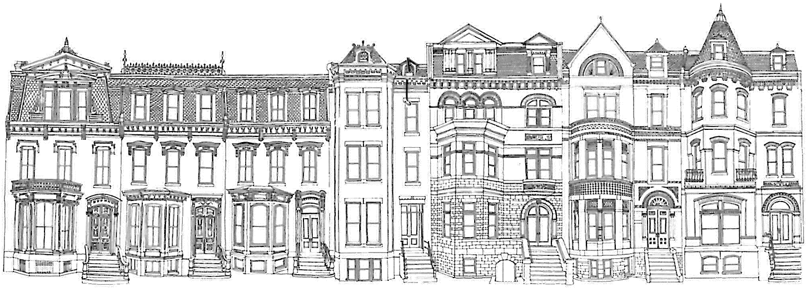
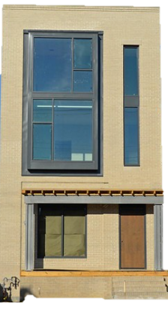
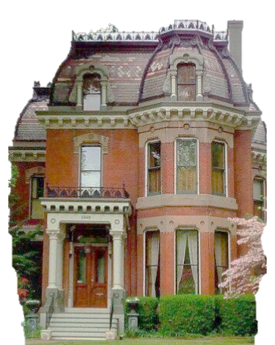
Part 1 Application: Property Eligibility
Individually listed on the NRHP
Contributing to a NRHP Historic District
OR

Slide 18
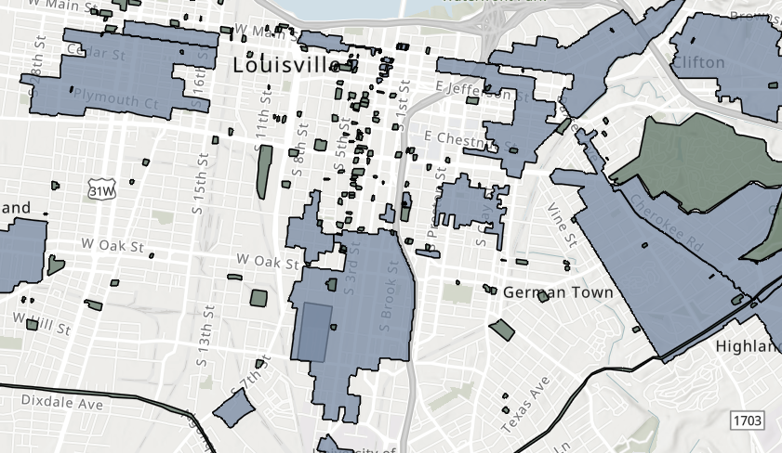
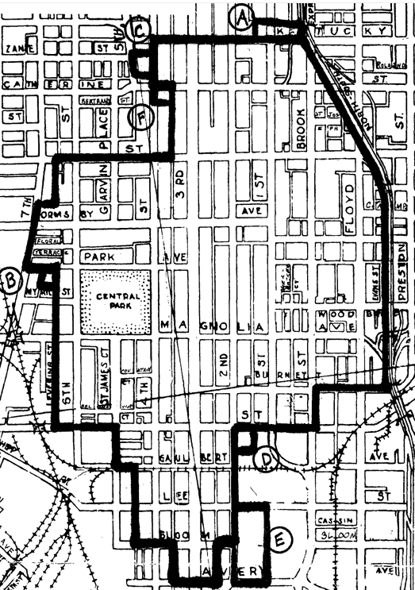
Old Louisville Residential Historic District
1972, 1975, 1984

Slide 19
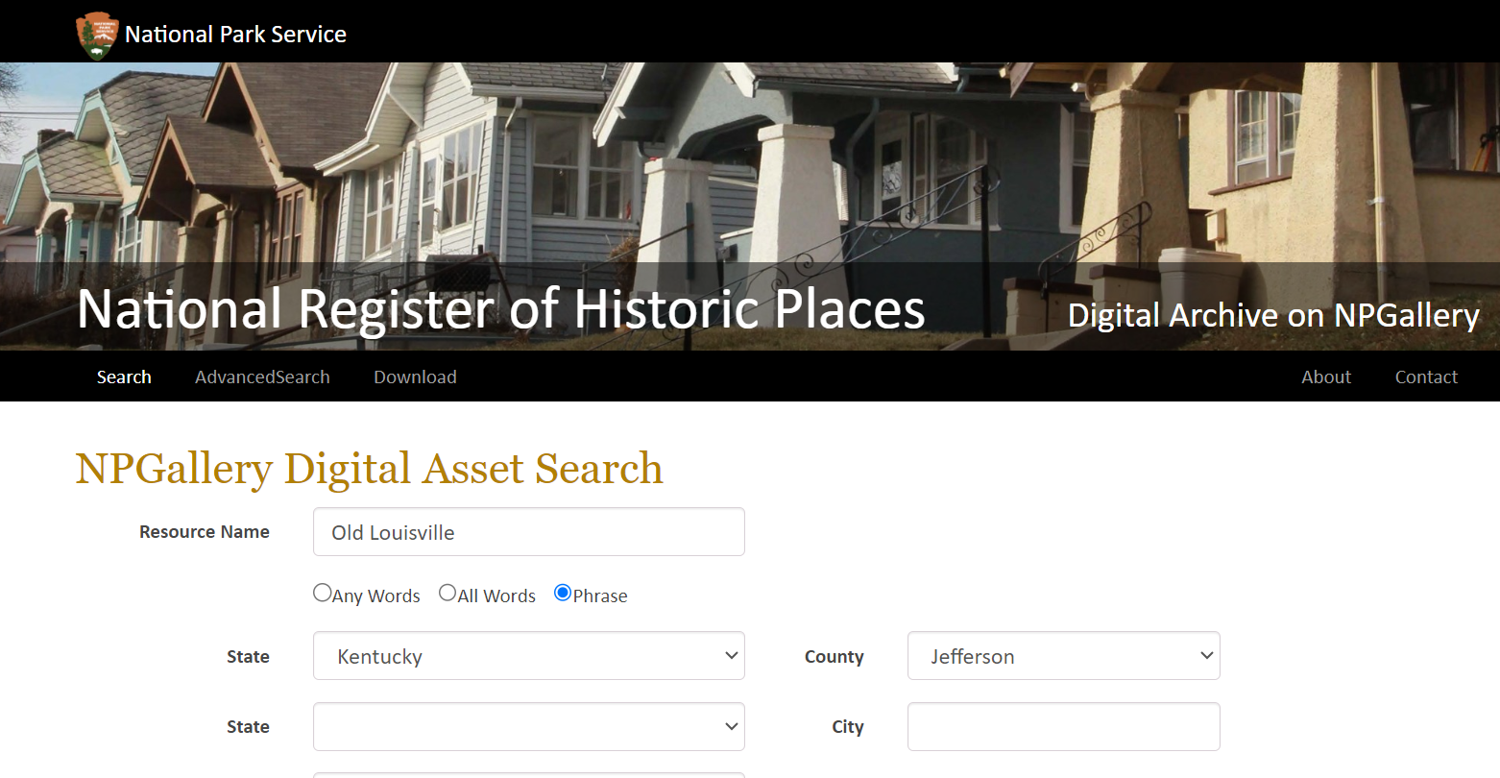
https://npgallery.nps.gov/nrhp

Slide 20
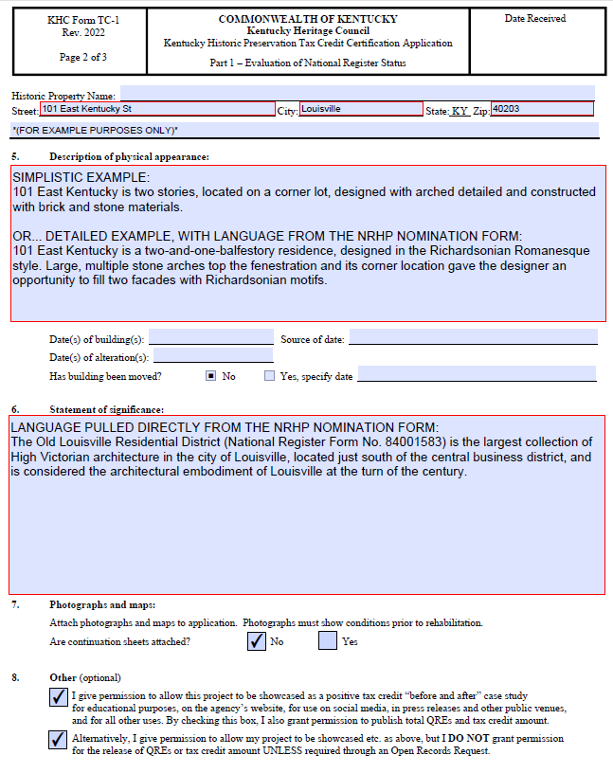
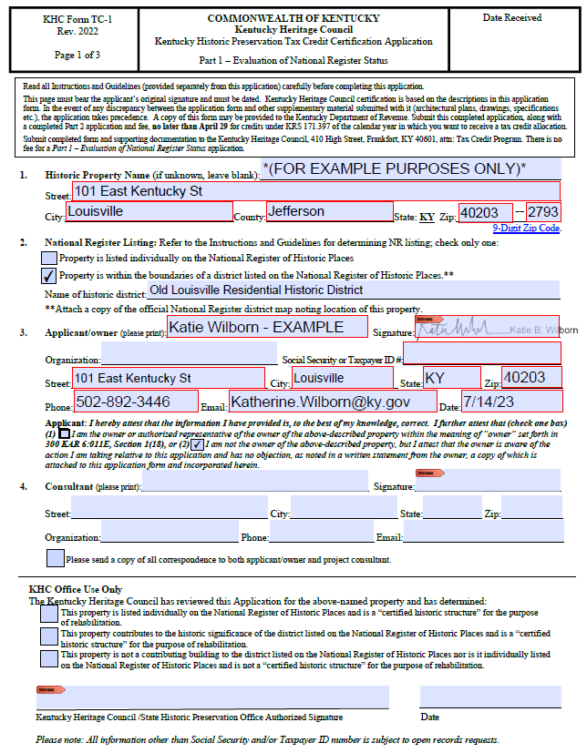
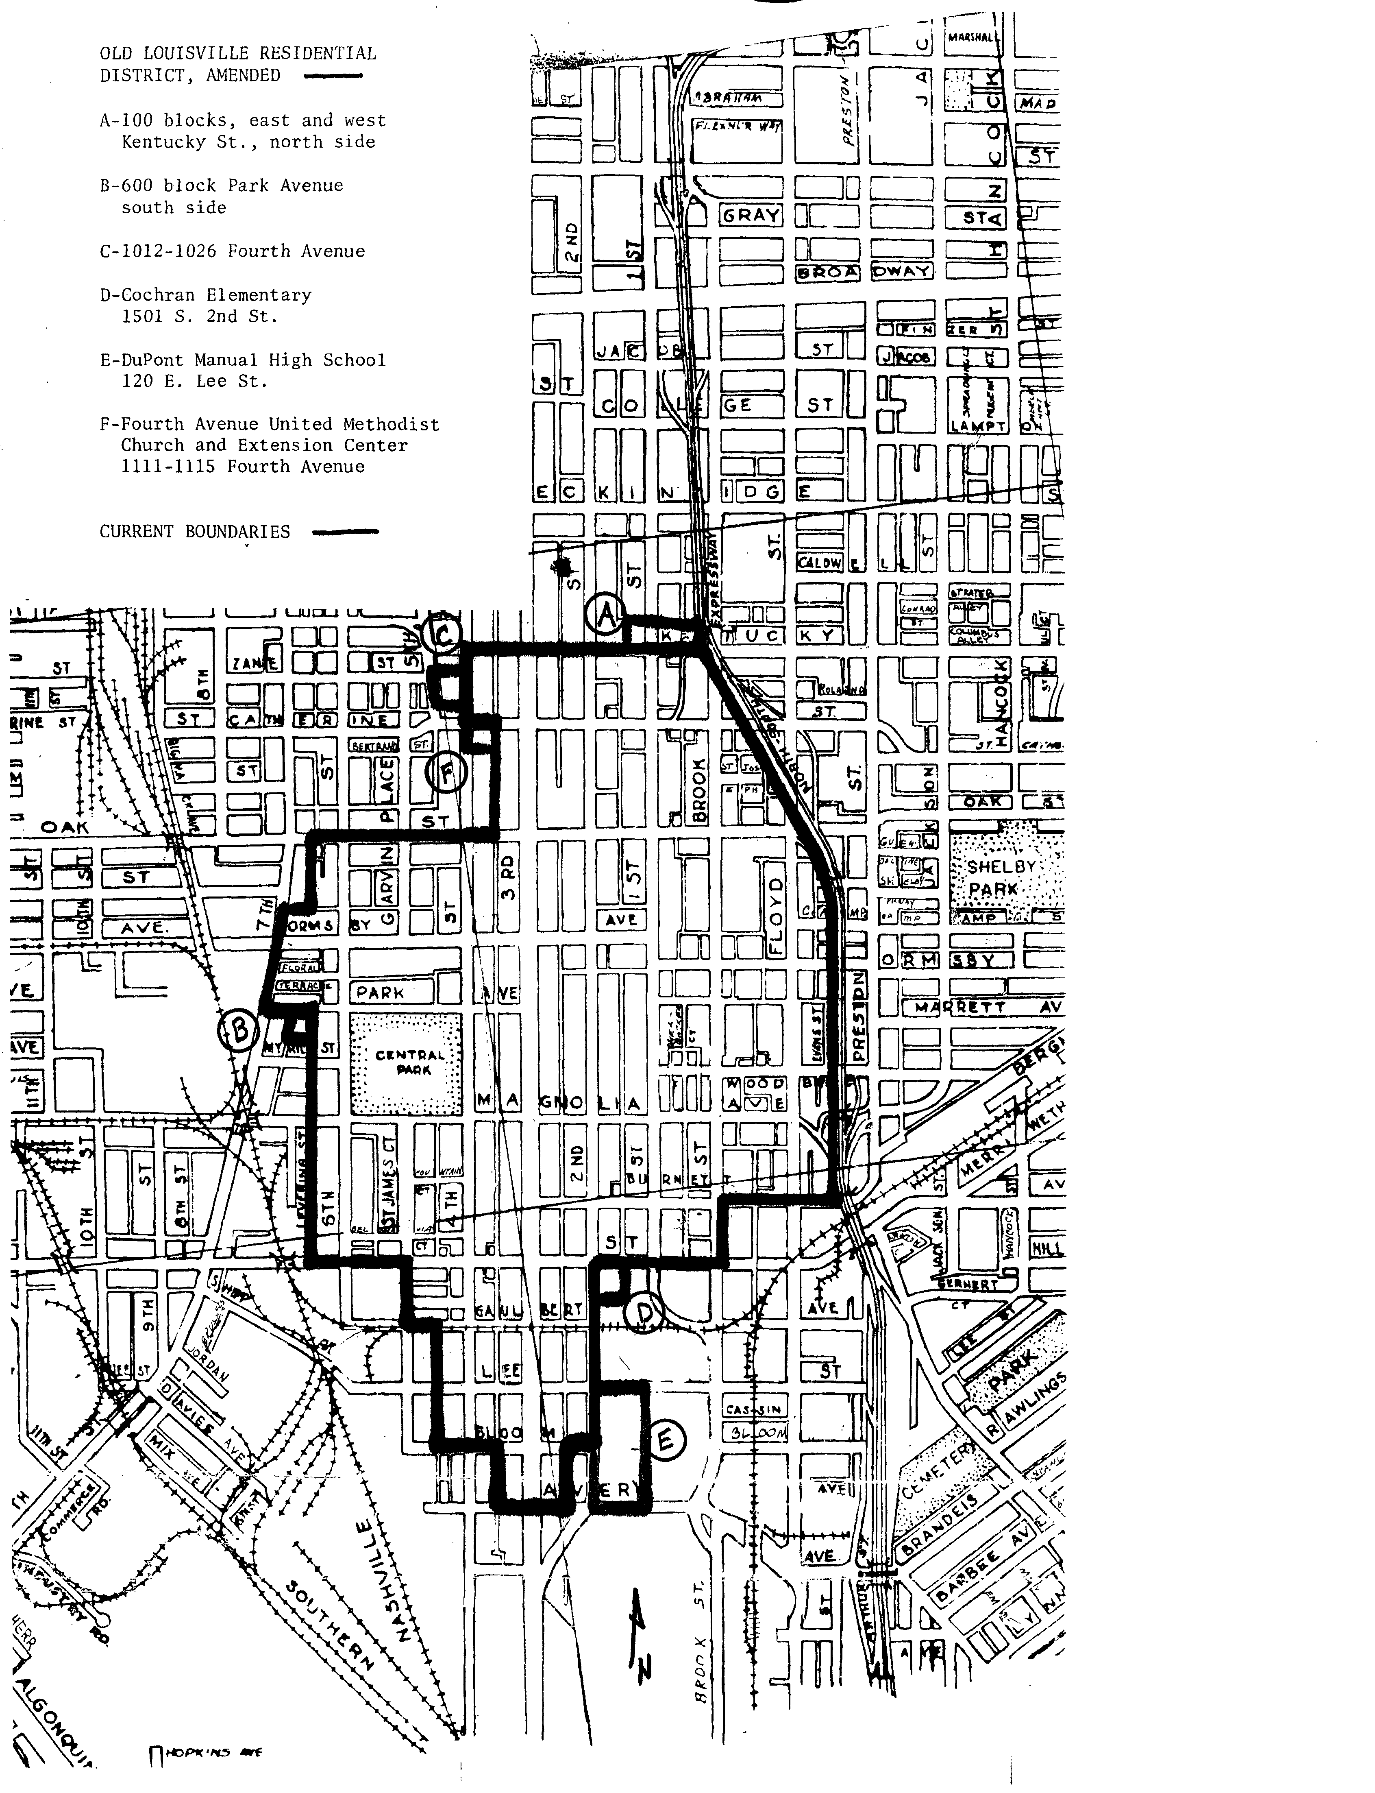
Part 1 Example

Slide 21
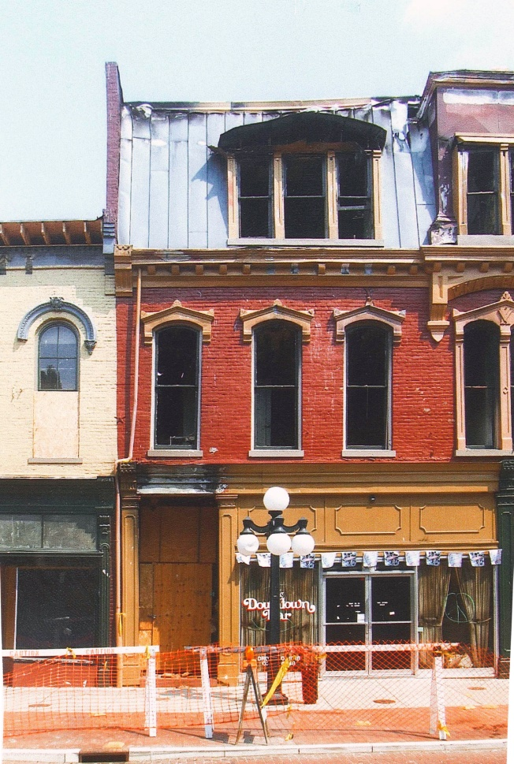
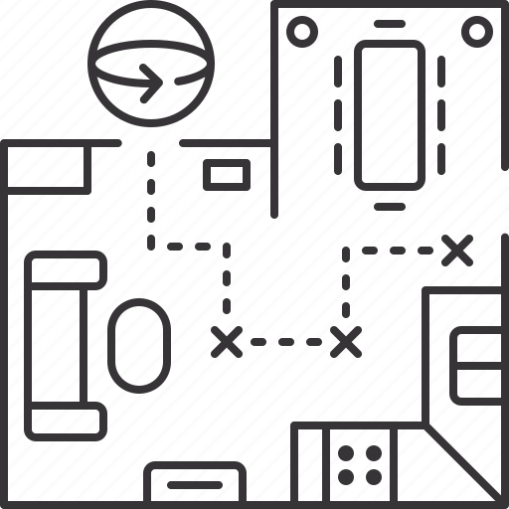
Part 2: Proposed Project
Estimated QREs
$
Before
Photo-Key Plan
Photo Form
All proposed work
24 Months
Description
w/ Allocation Year

Slide 22
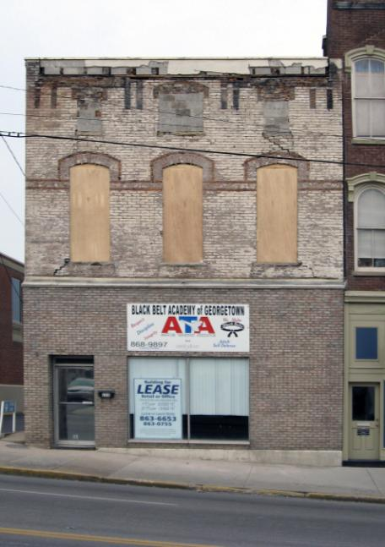
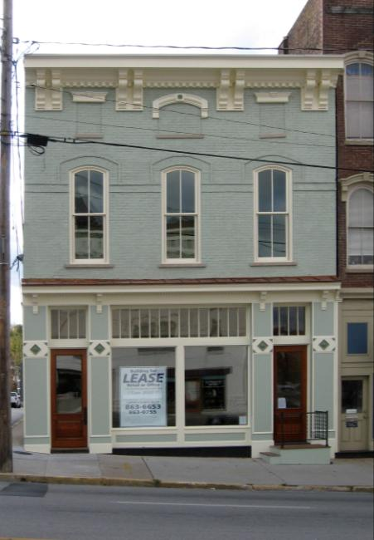
State Tax Credit Timeline
KHC’s Part 2 approval = Certifying the Project
Approvals take place all year
All Qualifying Rehabilitation Expenses (“QREs”)
24 Months
including Allocation year
Your project’s Allocation Year is the Fiscal Year your credits are allocated from.

Slide 23
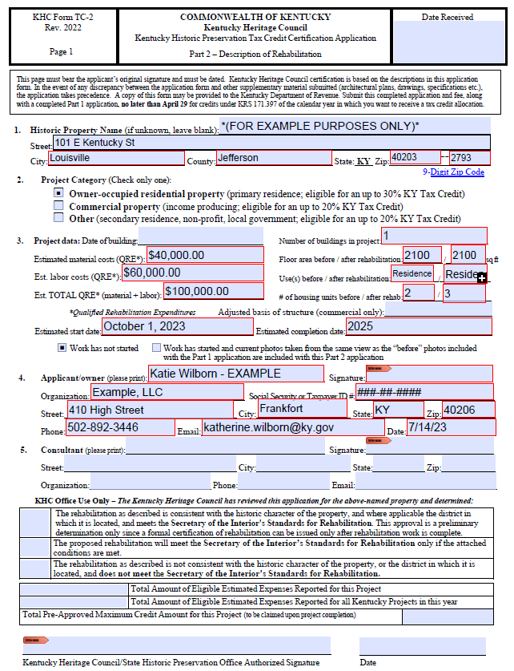
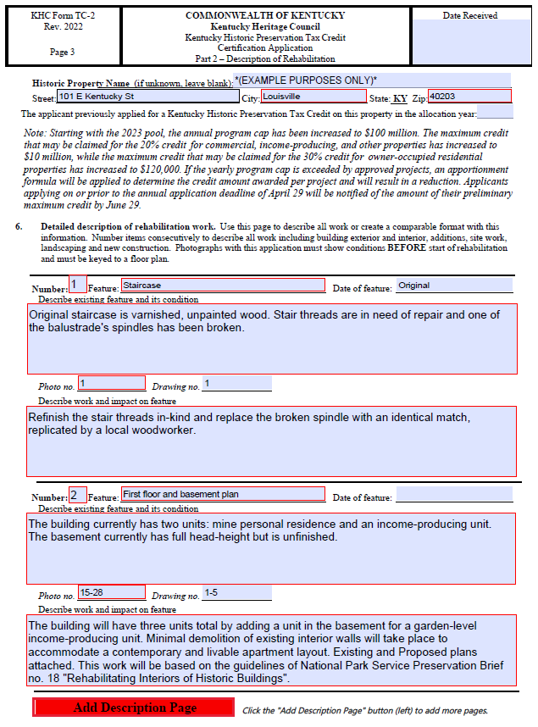
Part 2 Example

Slide 24
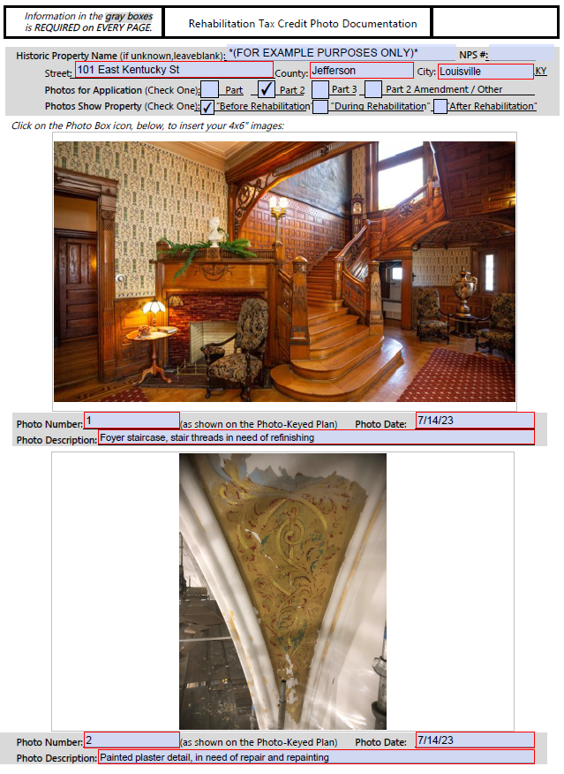
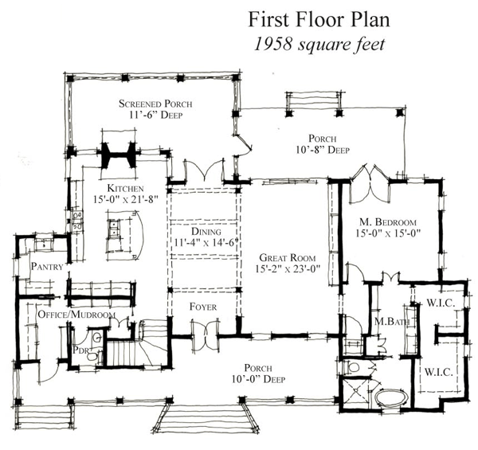
Photo Form Example
Photo Key Plan
1
2

Slide 25
Part 2 Common Questions:
Before
Photo-Key
Plan Required…
BEFORE project begins (best practice) or its at risk of denial.
Interior AND Exterior Photos Required.
2
3
1
…AND (E) & (P) floor
plans IF moving walls.

Slide 26
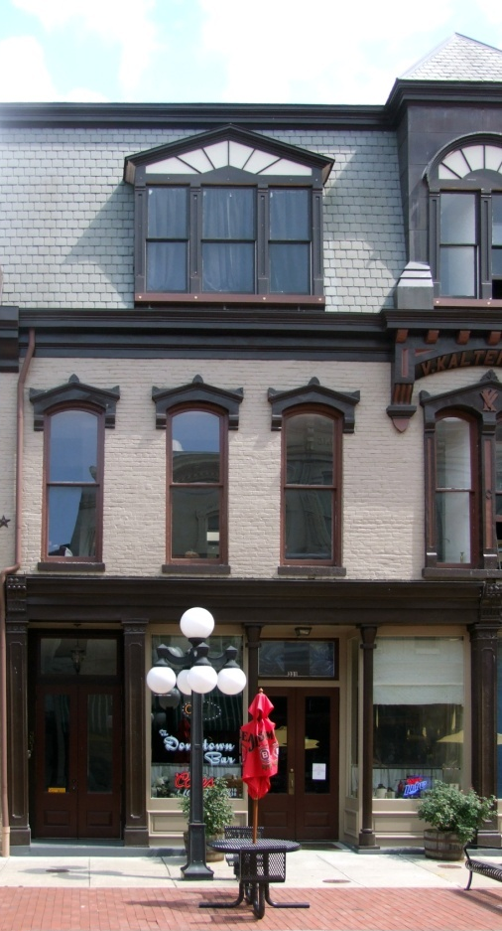
Part 3: Completed Project Review
$
Itemized Expenses
Final QREs
Review & Compare
Part 2
Before
After

Slide 27
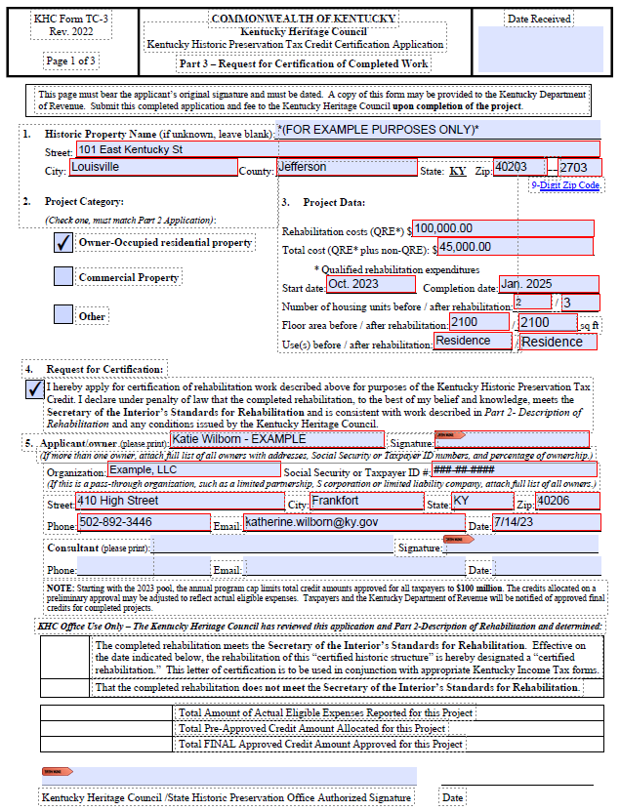
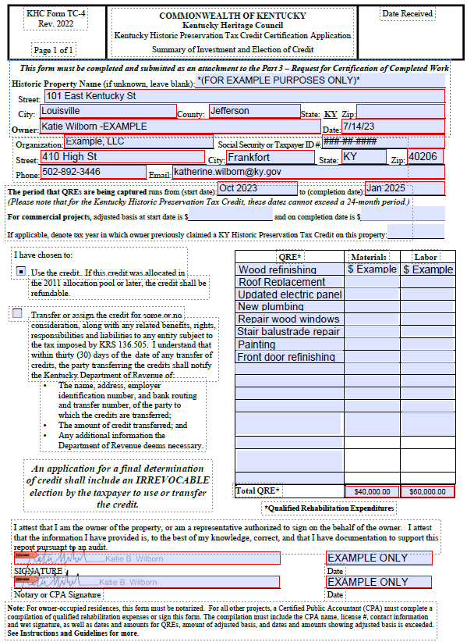
Part 3 Example

Slide 28
WHEN to apply:
HOW to be successful:
Reach out!
BEFORE the project begins.
Suggested: 2 months prior to work
Katherine.Wilborn@ky.gov
https://heritage.ky.gov/

Slide 29
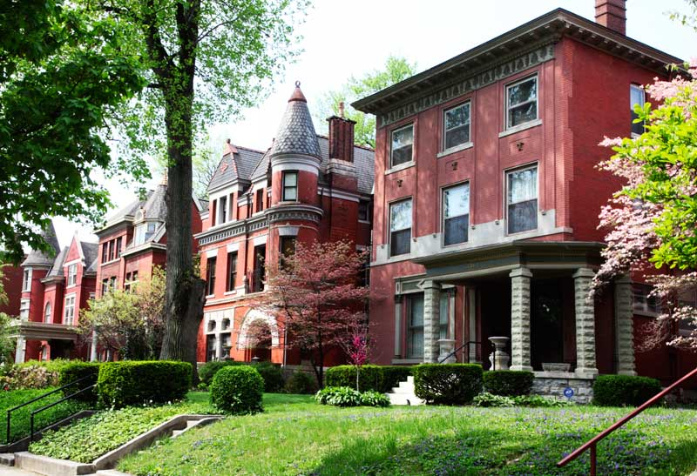
Questions?
Katie Wilborn, Site Development Program Administrator
Katherine.Wilborn@ky.gov
2023

